Slide 1
JSP Standard Tag Library

Slide 2
JSP Tags

Slide 3
Topics
What are JSP Tags?
Sample Use Case
Benefits

Slide 4
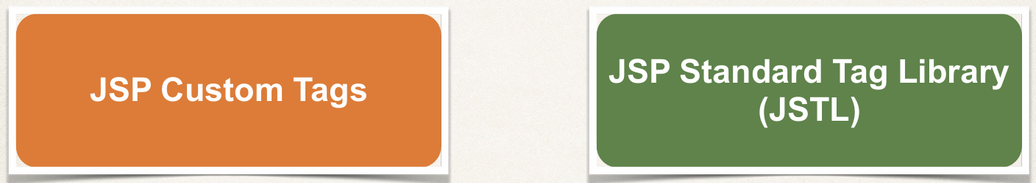
JSP Tags

Slide 5
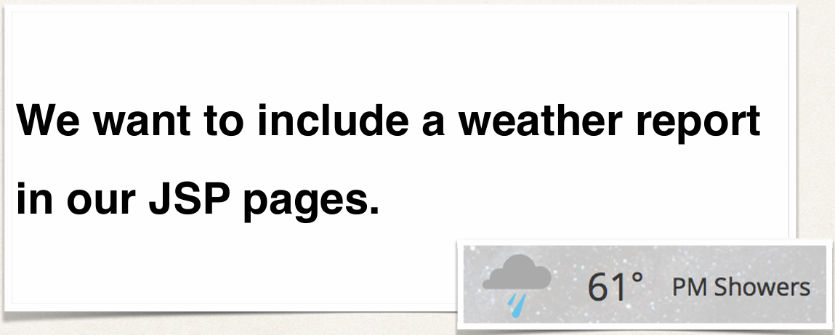
Problem
Email from: The Boss

Slide 6
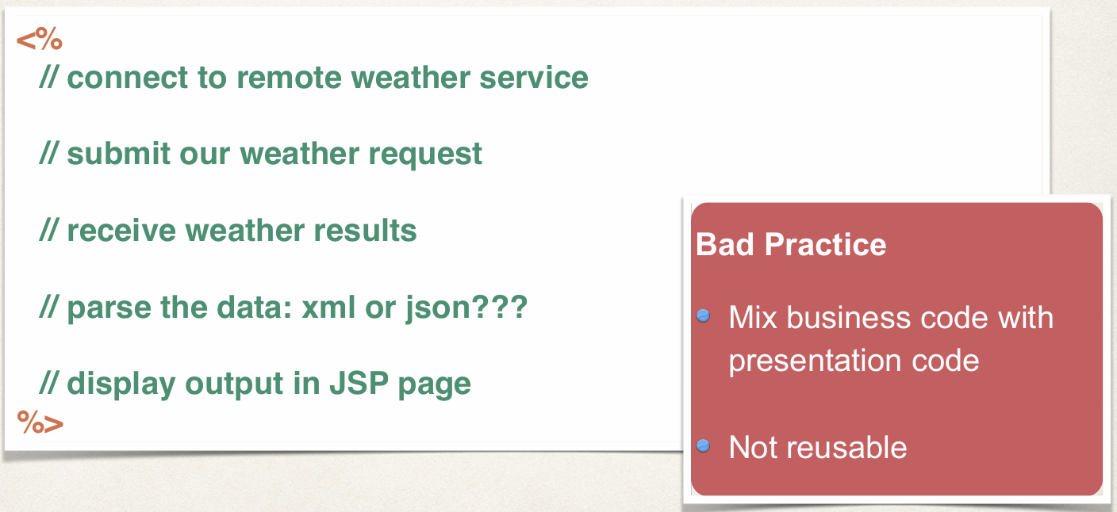
Option 1: Use Scriptlets

Slide 7

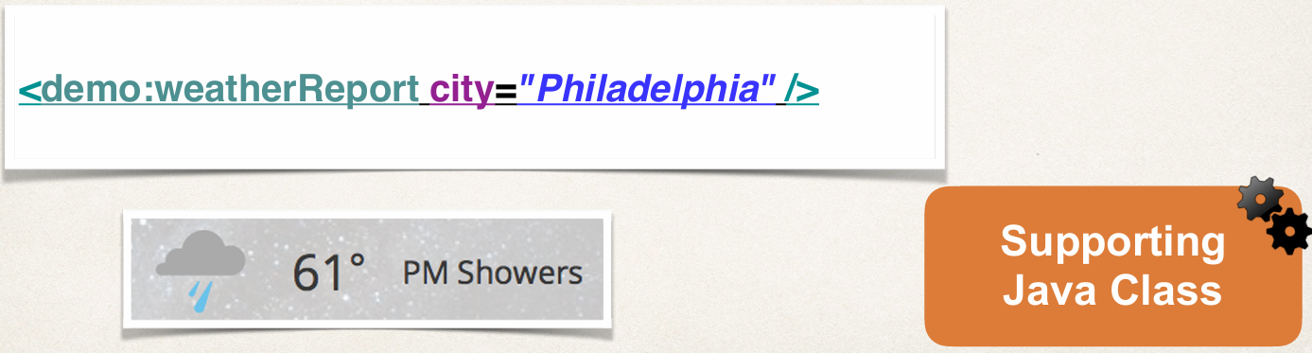
Option 2: JSP Custom Tags
Move heavy business logic into supporting class
Insert JSP custom tag to use supporting class

Slide 8


Benefits of JSP Custom Tags
Minimize the amount of scriptlet code in a JSP
Avoids dumping thousands of lines of code in a JSP
JSP page is simple … main focus of JSP is only the presentation
Tag is reusable

Slide 9
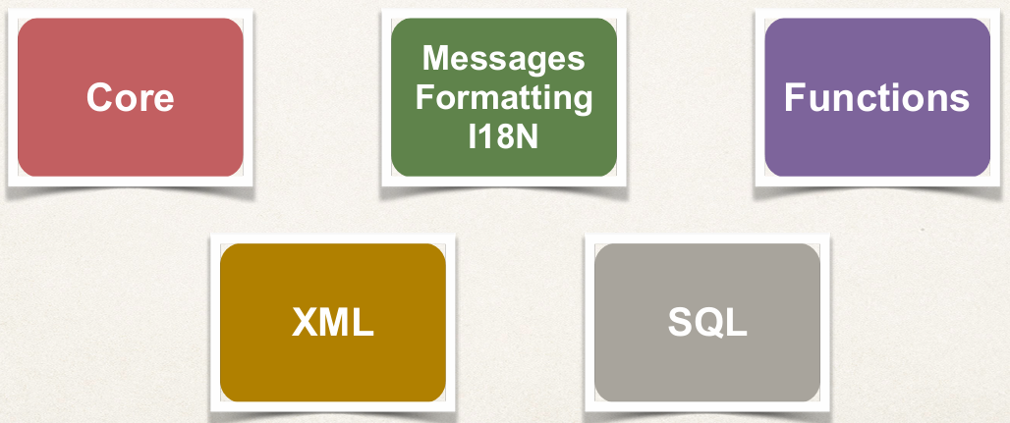
JSP Standard Tag Library (JSTL)
Oracle created a Specification for standard tags

Slide 10
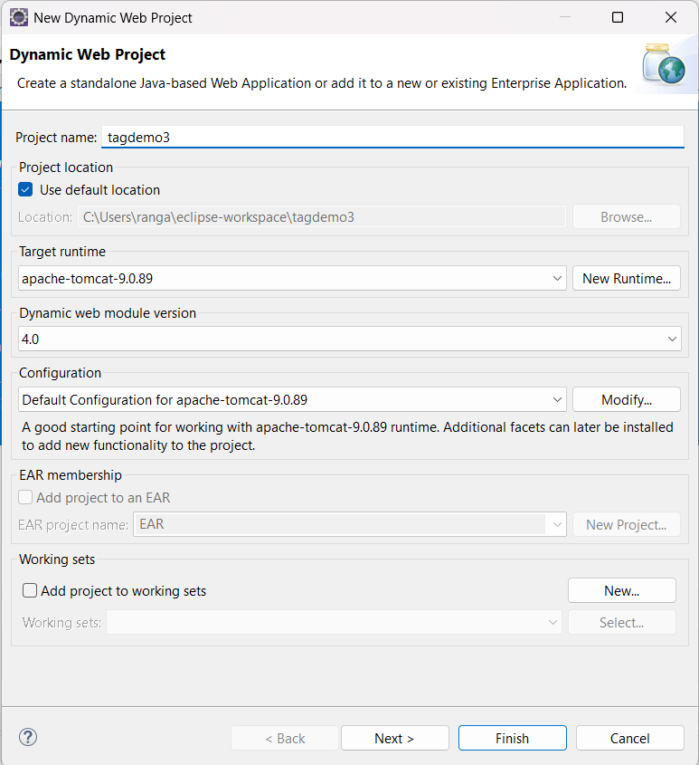
Create a new Dynamic Web Project

Slide 11
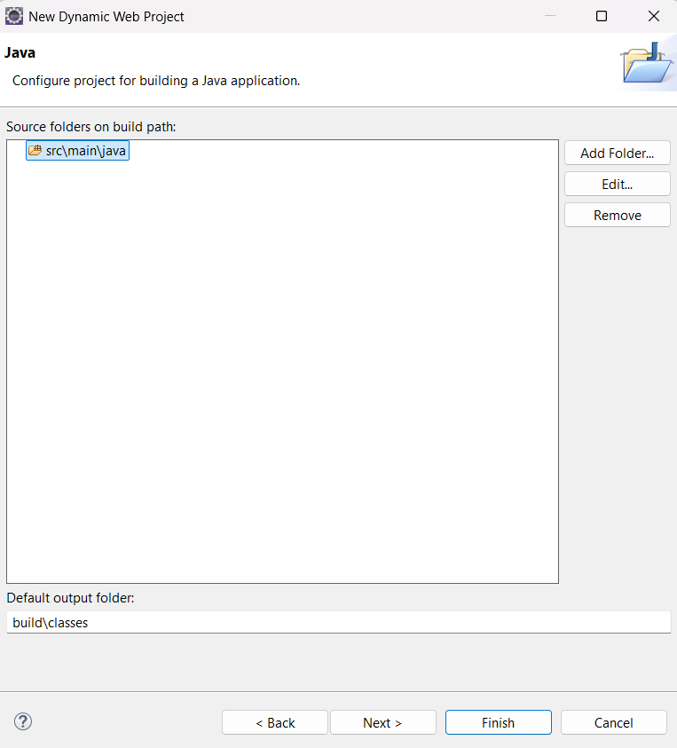
Remove this

Slide 12
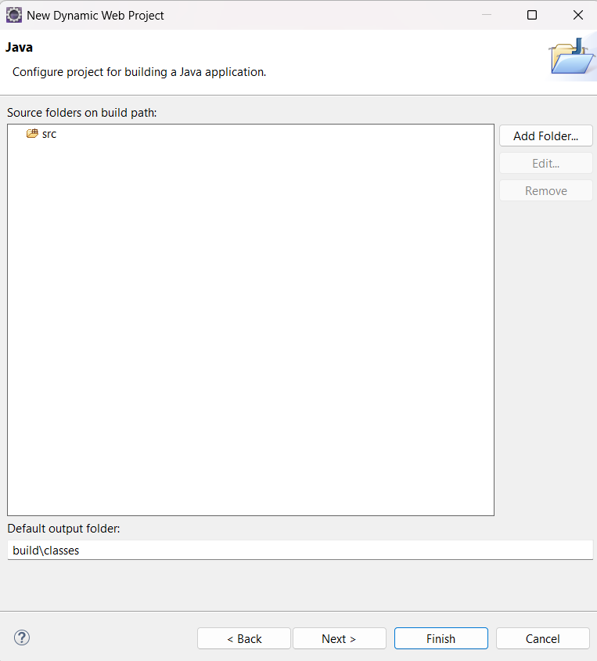
Create src folder

Slide 13
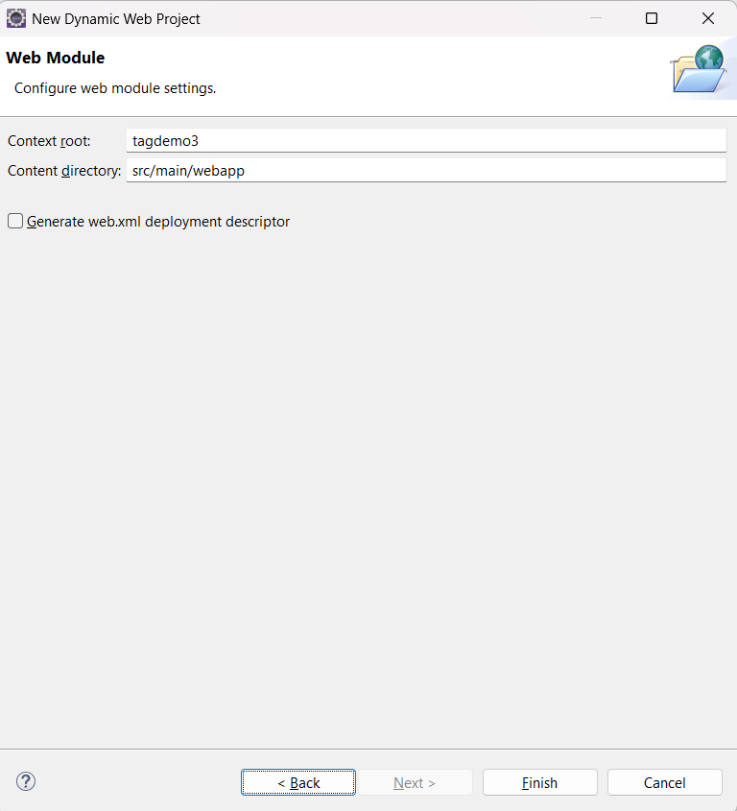
Change this as WebContent

Slide 14
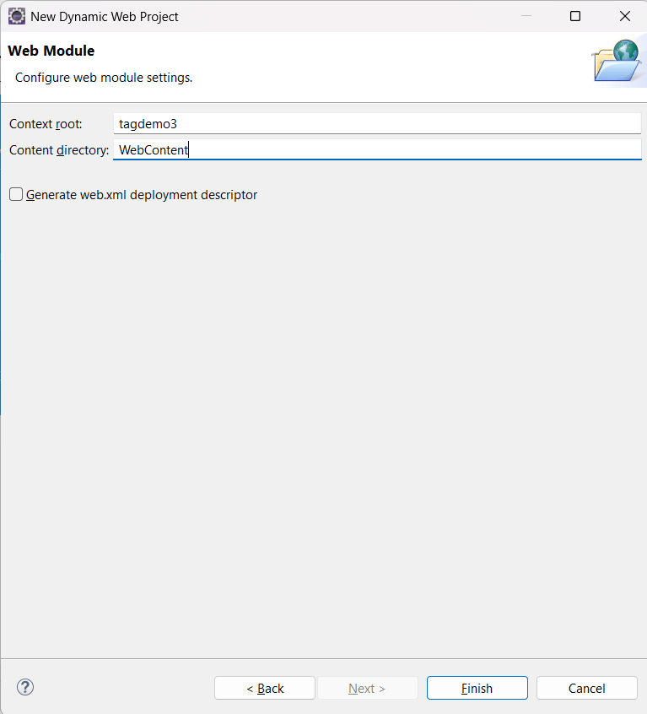
Changed

Slide 15
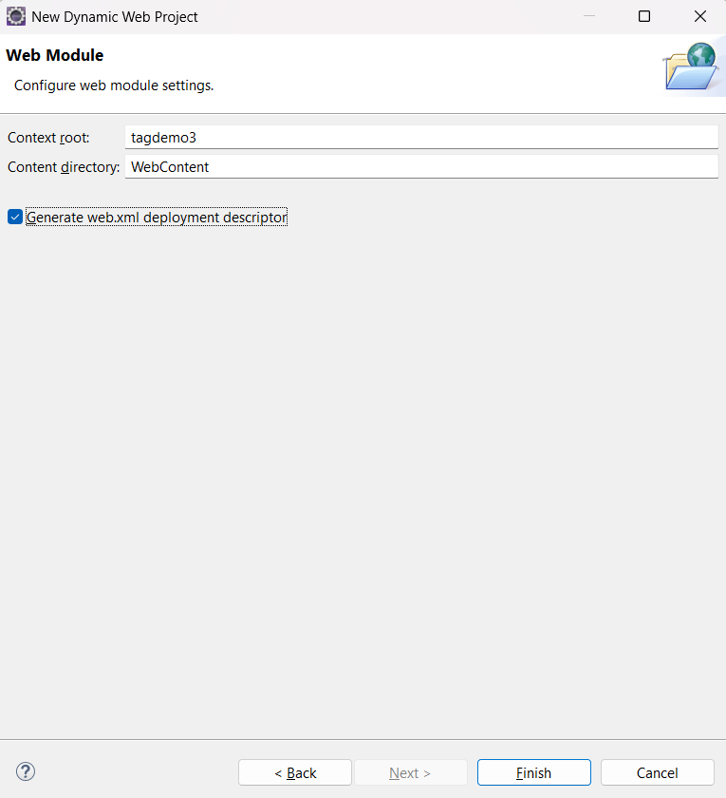
Click on Generate web.xml

Slide 16
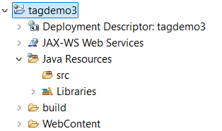

Slide 17
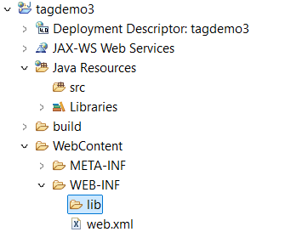
We need to add jar files to lib directory

Slide 18
Downloadables
Javax.servlet.jsp.jstl-1.2.1.jar
Javax.servlet.jsp.jstl-api-1.2.1.jar

Slide 19
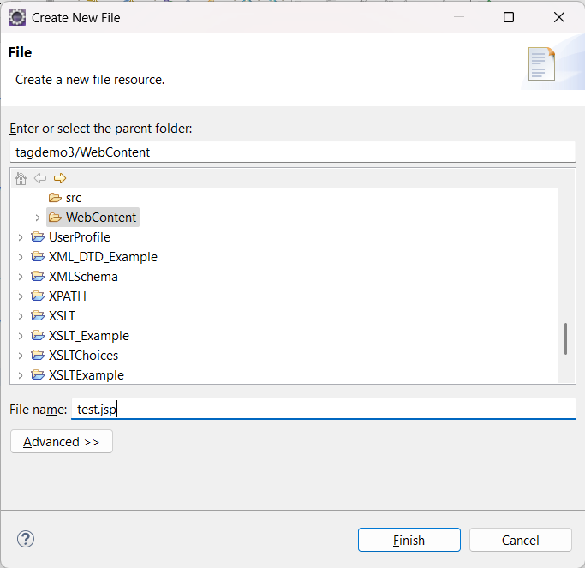
Create a test.jsp file

Slide 20
Add the below content to test.jsp
<%@ taglib uri="http://java.sun.com/jsp/jstl/core" prefix="c" %>
<html>
<body>
<c:set var=“stuff” value=“<%= new java.util.Date() %>” />
Time on the server is ${stuff}
</body>
</html>

Slide 21
Download link for jstl
https://mvnrepository.com/artifact/org.glassfish.web/javax.servlet.jsp.jstl/1.2.1
https://mvnrepository.com/artifact/javax.servlet.jsp.jstl/javax.servlet.jsp.jstl-api/1.2.1

Slide 22
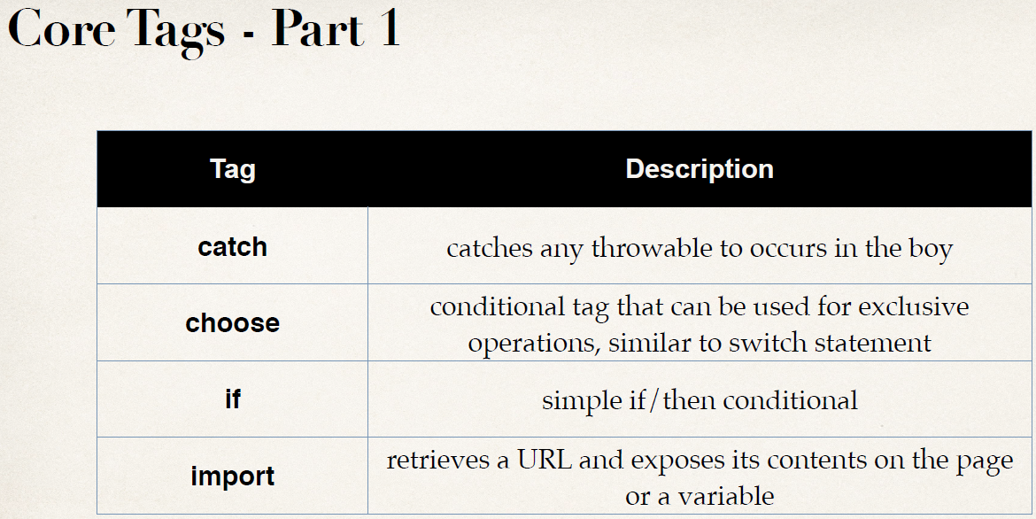

Slide 23
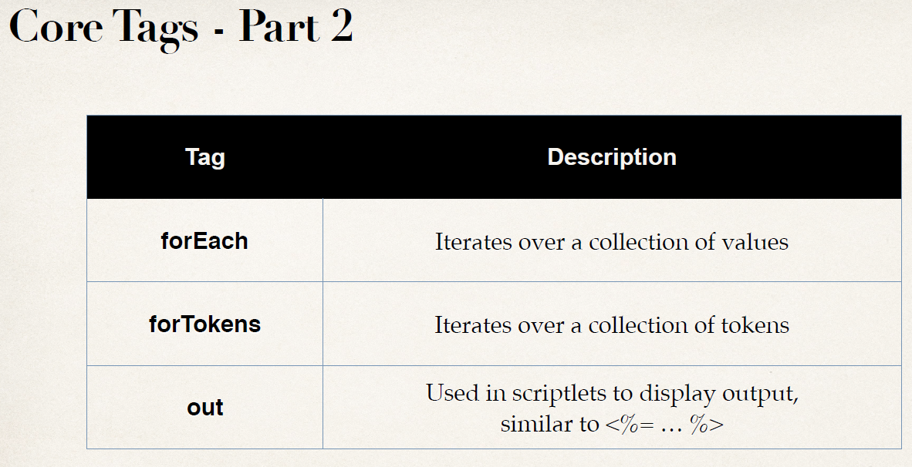

Slide 24
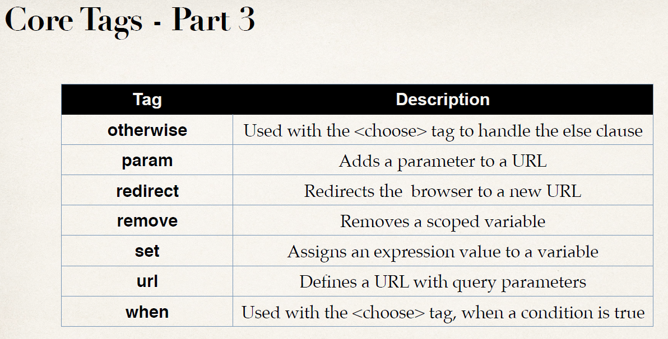

Slide 25
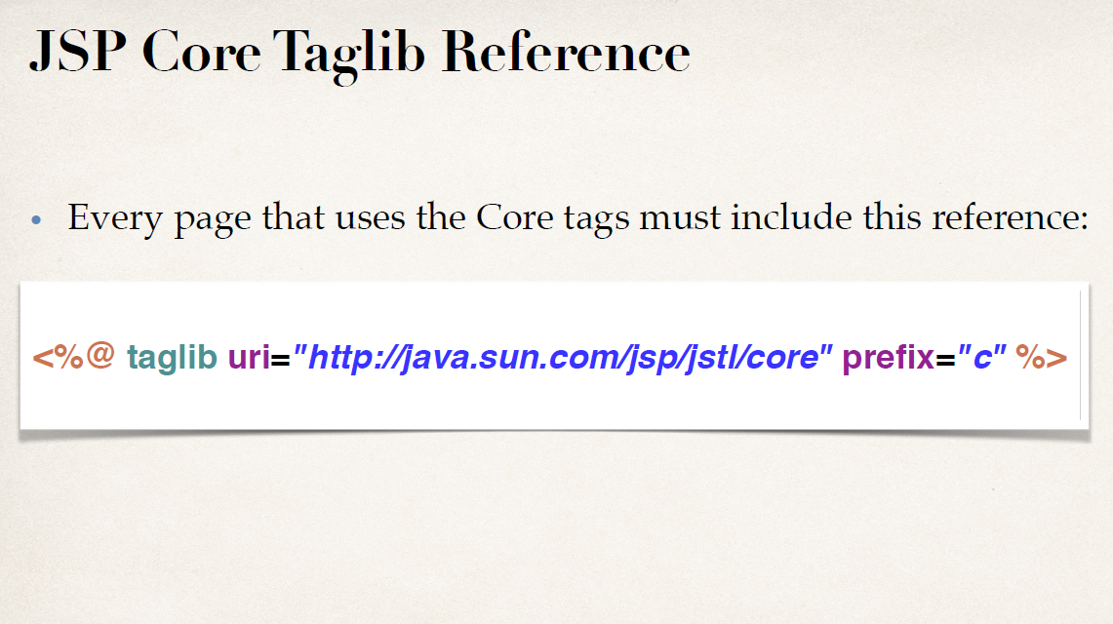

Slide 26
Create a new jsp page (for-each-simple-test.jsp)
<%@ taglib uri="http://java.sun.com/jsp/jstl/core" prefix="c" %>
<%
// Just create some sample data
String[] cities = {"Chennai", "Singapore", "Mumbai"};
pageContext.setAttribute("myCities", cities);
%>
<html>
<body>
<c:forEach var="tempCity" items="${myCities}">
${tempCity } <br>
</c:forEach>
</body>
</html>

Slide 27
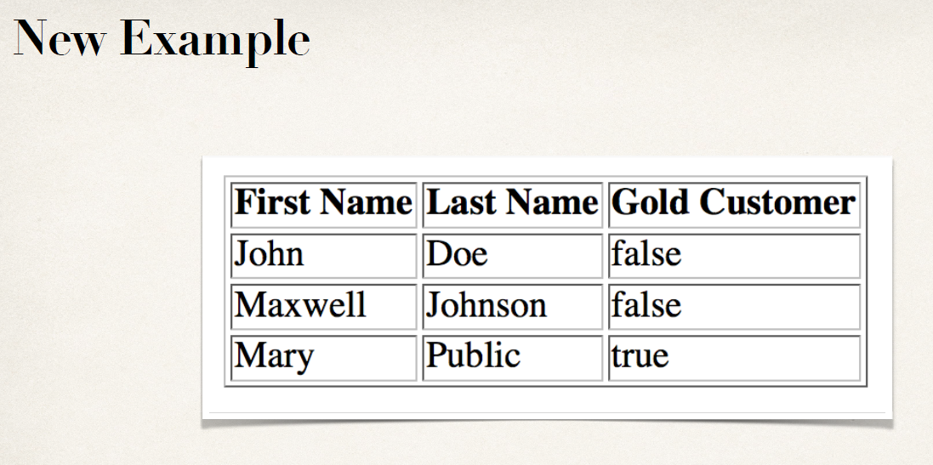

Slide 28
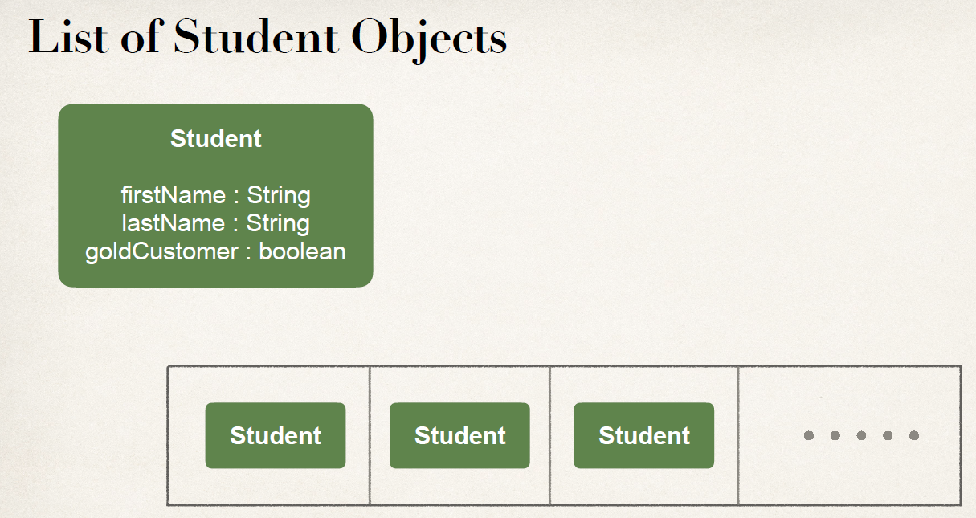

Slide 29
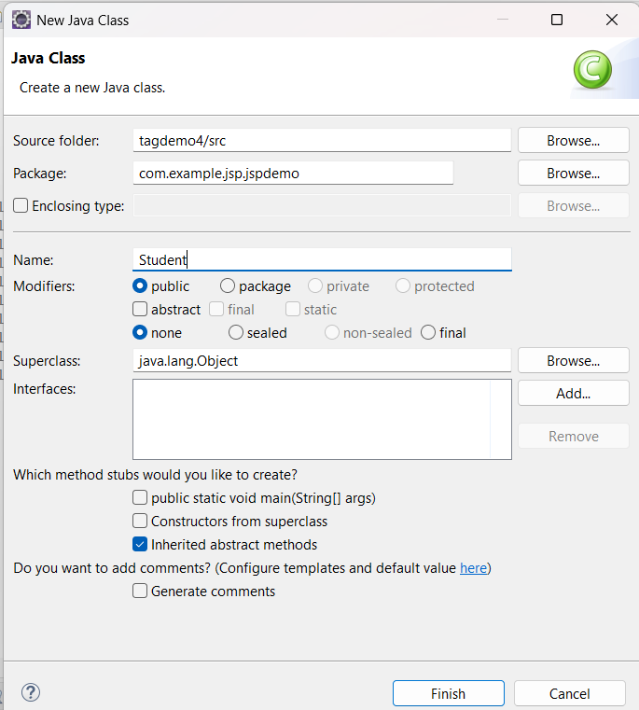

Slide 30
package com.example.jsp.jspdemo;
public class Student {
private String firstName;
private String lastName;
private boolean goldCustomer;
public Student(String firstName, String lastName, boolean goldCustomer) {
super();
this.firstName = firstName;
this.lastName = lastName;
this.goldCustomer = goldCustomer;
}
public String getFirstName() {
return firstName;
}
public void setFirstName(String firstName) {
this.firstName = firstName;
}
public String getLastName() {
return lastName;
}
public void setLastName(String lastName) {
this.lastName = lastName;
}
public boolean isGoldCustomer() {
return goldCustomer;
}
public void setGoldCustomer(boolean goldCustomer) {
this.goldCustomer = goldCustomer;
}}

Slide 31
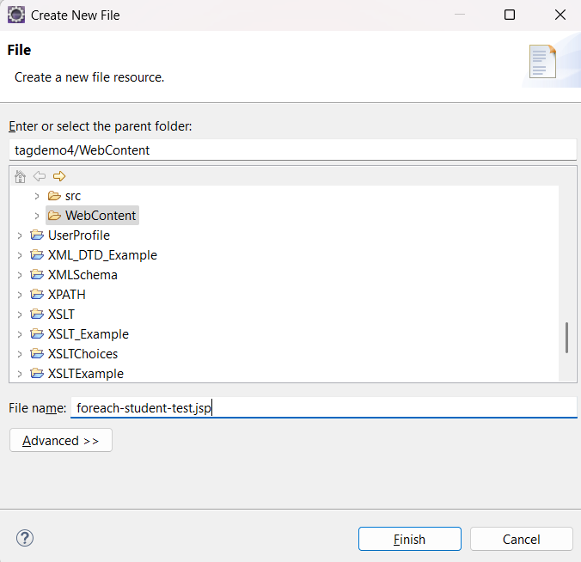

Slide 32
<%@ taglib uri="http://java.sun.com/jsp/jstl/core" prefix="c" %>
<%@ page import="java.util.*, com.example.jsp.jspdemo.Student" %>
<%
// Just create some sample data....normally provided by MVC
List<Student> data = new ArrayList<>();
data.add(new Student("John", "Doe", false));
data.add(new Student("Maxwell", "Johnson", false));
data.add(new Student("Mary", "Public", true));
pageContext.setAttribute("myStudents", data);
%>
<html>
<body>
<c:forEach var="tempStudent" items="${myStudents}">
${tempStudent.firstName}, ${tempStudent.lastName }, ${tempStudent.goldCustomer}
<br>
</c:forEach>
</body>
</html>

Slide 33
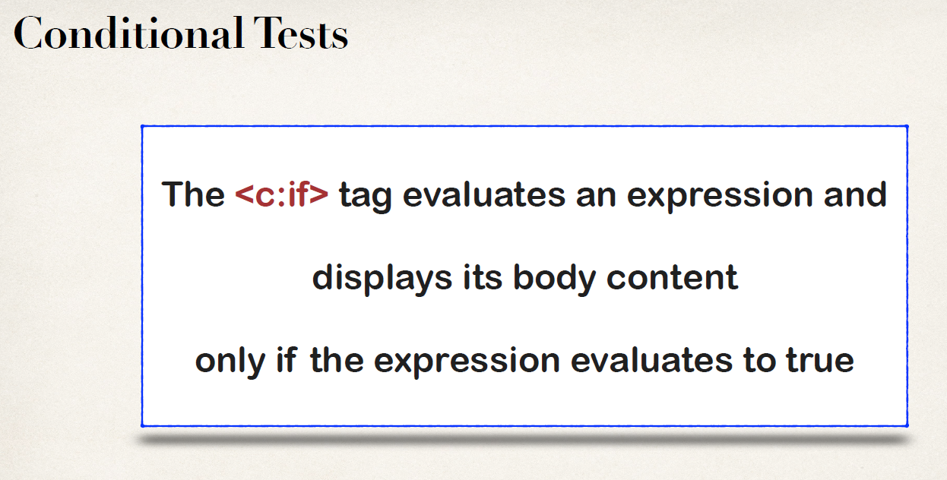

Slide 34
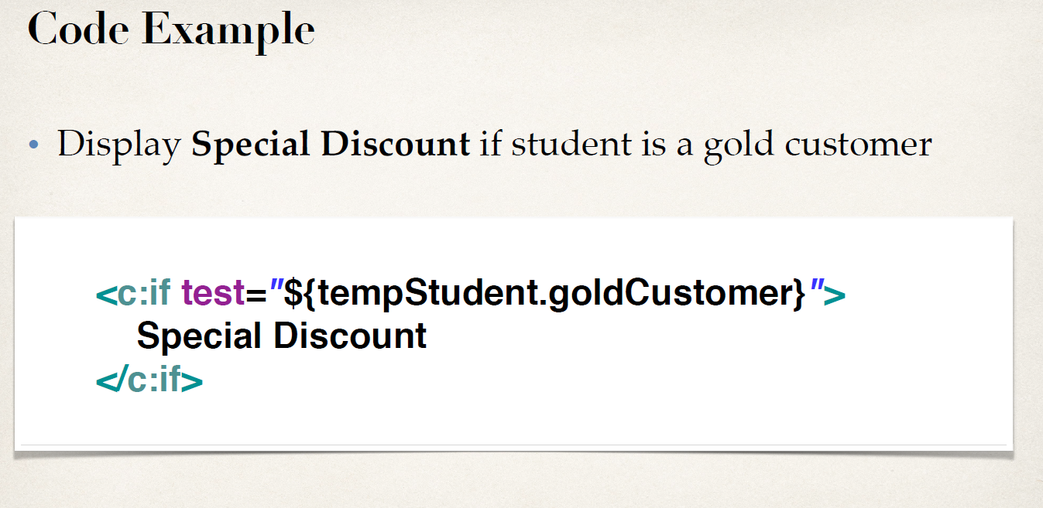

Slide 35
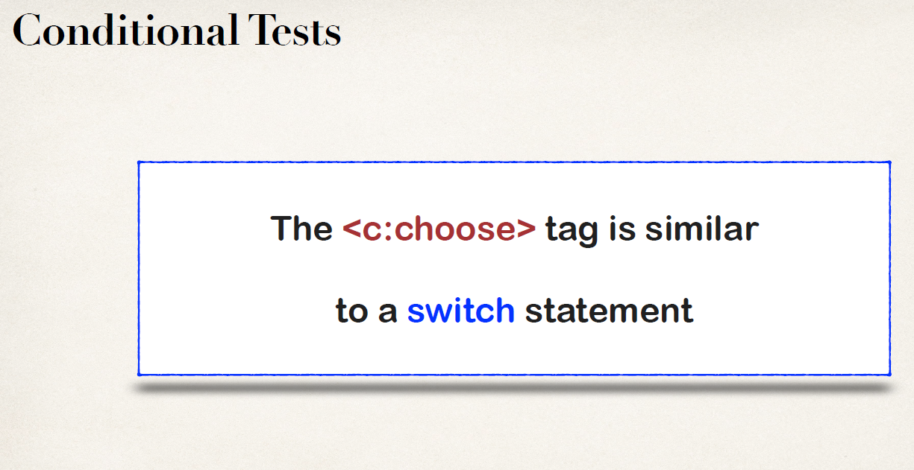

Slide 36
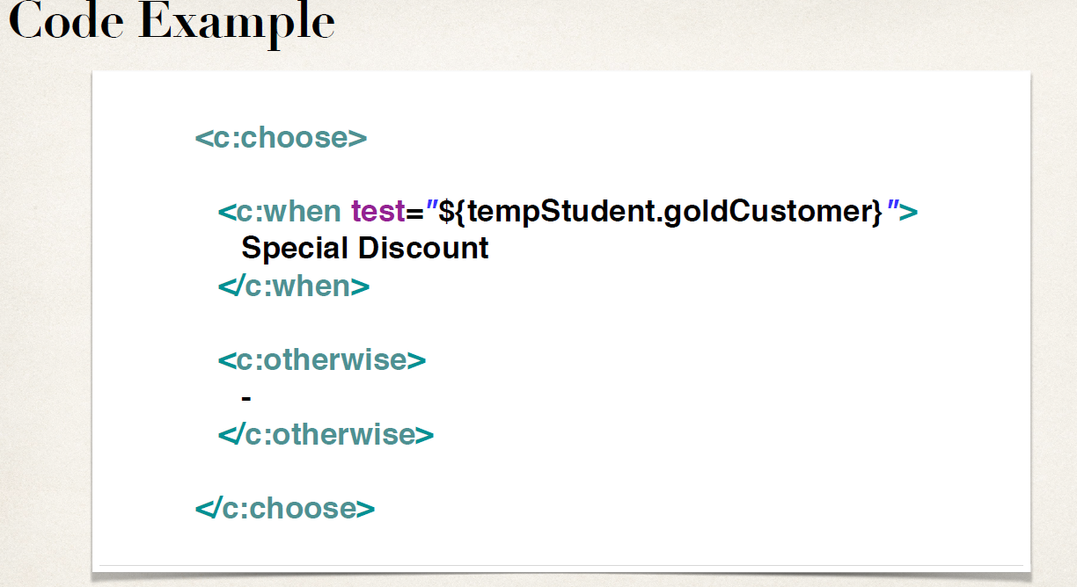

Slide 37
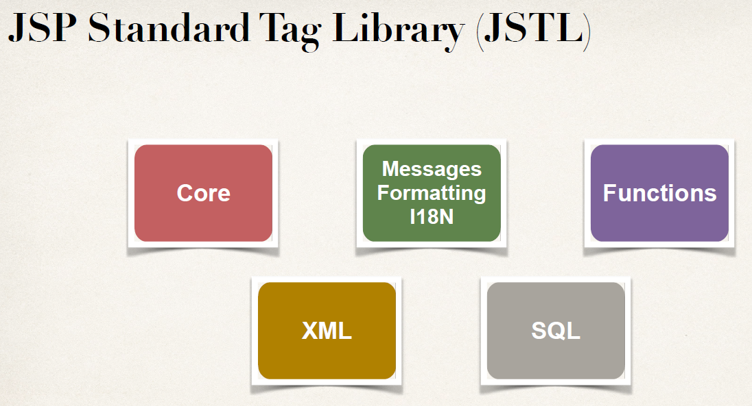

Slide 38
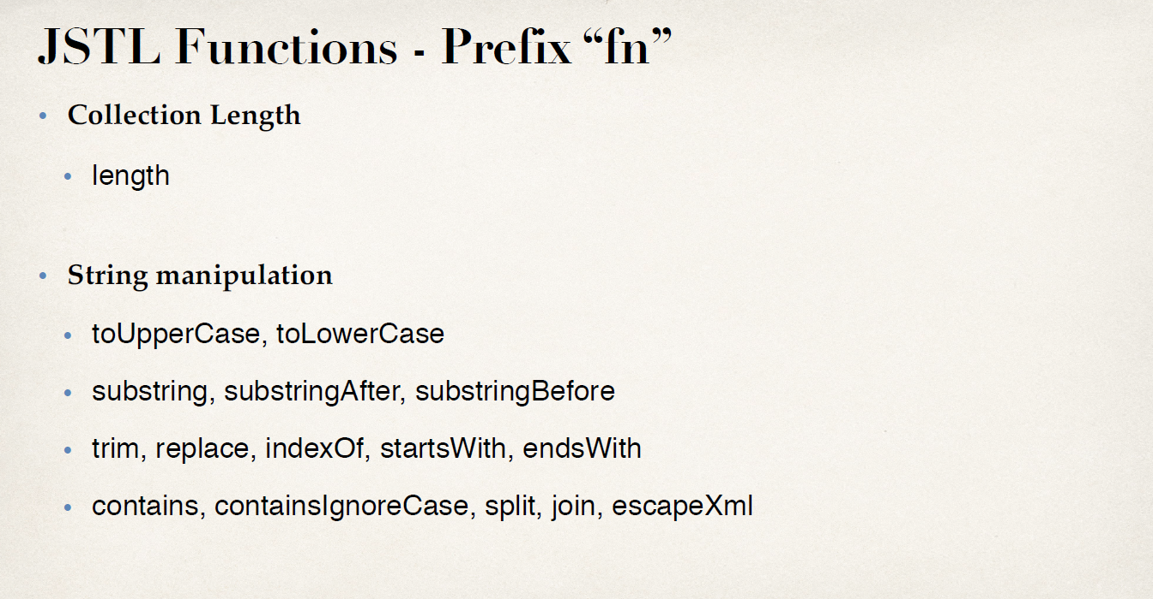

Slide 39
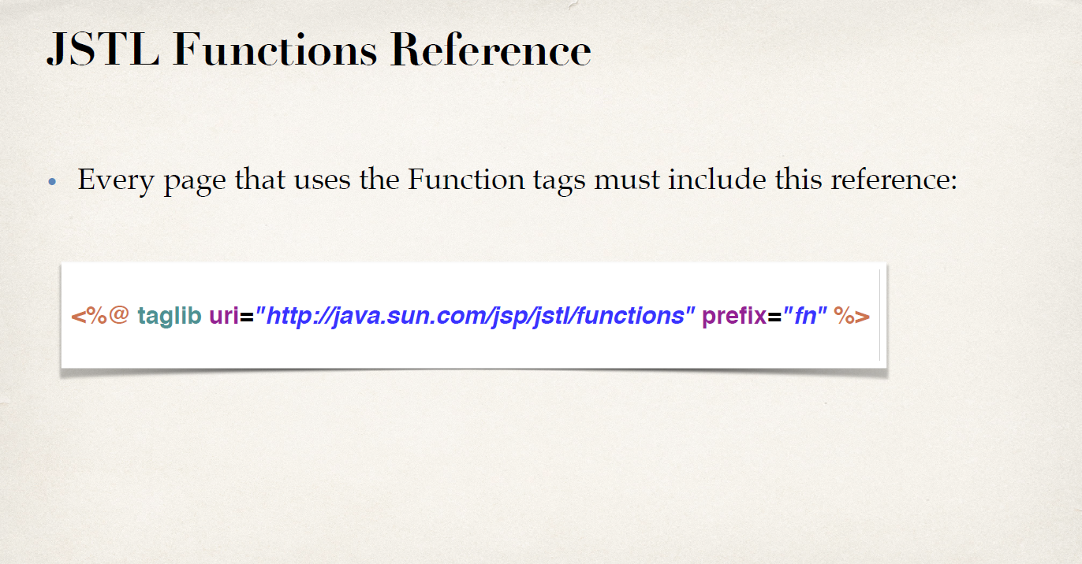

Slide 40
